Slide 1

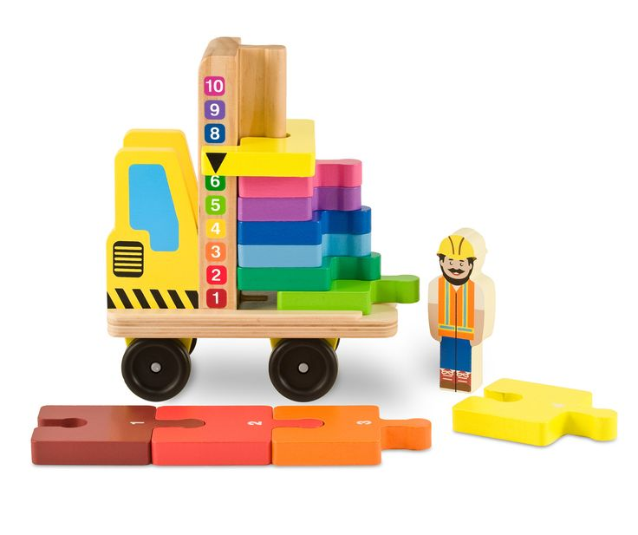
Stack & Count Forklift
Toy Name
Stack & Count Forklift
Manufacturer
Melissa & Doug
Age
24 months – 36 months
Parts
1 Wooden Vehicle
1 Driver
10 Number Tiles
1 Sliding Counter Tile
Develop Skills
Fine Motor
Imagination
Social
Cognitive
How it Works
Susunlah kepingan secara bertumpuk sampai tinggi di atas truk atau jejerkanlah di lantai! Doronglah truk untuk permainan imaginatif yang menyenangkan!
-
Stack the tiles high on the truck bed or line them up on the floor! Roll the truck around for some imaginative fun!
How To Clean
Simply clean using a cloth that has been sprayed with non-toxic anti bacterial solution
Warning
Store in a dry place
Keep out of direct sunlight

